Slide 1

PEOPLE SERVING PEOPLE

Slide 2



SERVICIO
Unveiling the Challenges of NGOs in INDIA
Non-governmental organizations (NGOs) are a major force for social change in India. They address a range of issues. However, NGOs in India face a number of challenges in their efforts to make a positive impact.
2022
Company

Slide 3



SERVICIO
FUNDING SHORTAGES
LACK OF VISIBILITY
UNEQUAL DISTRIBUTION OF RESOURCES
One of the biggest problems that NGOs in India face is a lack of funding. Most NGOs rely on donations and grants from international, national, and individual organizations and corporations but these sources of funding are often unreliable and insufficient. In order to secure more reliable and sufficient funding, NGOs in India must find creative ways to attract donors.
Another major problem faced by NGOs in India is a lack of visibility. Many NGOs struggle to make their work known to the public, which makes it difficult for them to attract donors and volunteers.
The resources available to NGOs are limited, and the distribution of these resources is often inequitable. This can create a cycle of poverty and disadvantage for those who are already disadvantaged.

Slide 4



SERVICIO
ABOUT SERVICIO
A public website called The Servicio provides a platform for collaboration between non-governmental organizations and those in need. This website's primary objective is to reduce the amount of groundwork required for NGOs and work in partnership with them to promote public welfare to the highest degree possible.
2

Slide 5
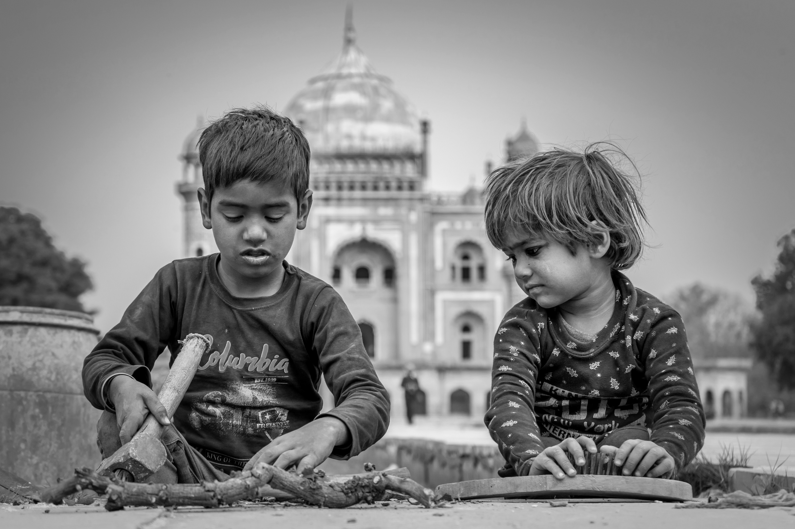

SERVICIO
Why we need Servicio?
Creating an online platform that helps NGOs in India solve the problems they face everyday, to connect NGOs with potential donors, volunteers and resources. Through the platform, NGOs can post their needs and donors can find out which NGO to donate to. The platform can also provide information on government schemes and programs to help NGOs tackle hunger and poverty in India.

Slide 6


SERVICIO
OUR SERVICES
Improving access to services is an important goal for NGOs
GOVERNMENTAL AND NON-GOVERNMENTAL SCHEMES
AWARENESS PROGRAMS
Non-governmental organizations (NGOs) play a crucial role in raising awareness of governmental and non- governmental schemes that are available to citizens. Advocacy is a key tool for NGOs in raising awareness of schemes. Through our website, NGOs can help to bring attention to the schemes and encourage citizens to take advantage of them.
Awareness programs are an important tool for NGOs, as they can help to increase public knowledge and understanding of the issues faced by the organization. They can also be used to promote positive change and encourage people to take action. By using our website NGOs can partner with other organizations, and can ensure that their awareness programs are effective and have a lasting impact on the issues they are addressing.

